Slide 1
AES_Project_2021_2022
Politecnico di Milano
Automation and Control Engineering
Group’s Members:
Borgnino Michele
Crespi Davide Marco
Riva Alessandro
Firetto Alessandro

Slide 2
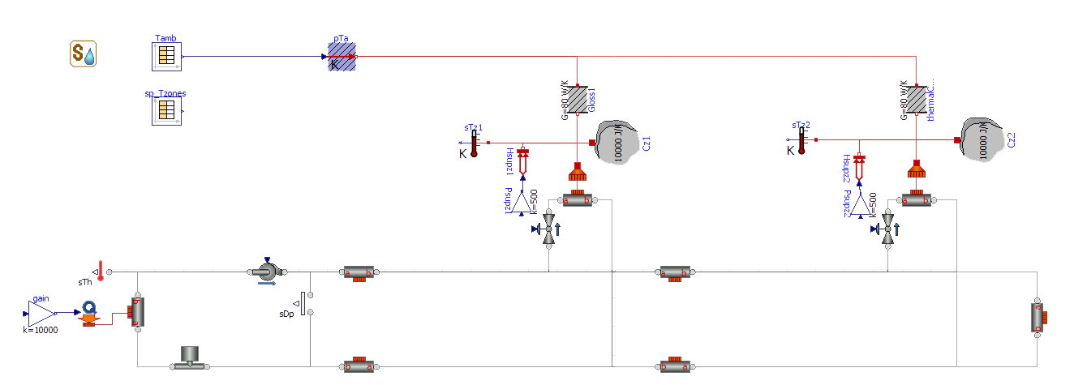
Uncontrolled system

Slide 3
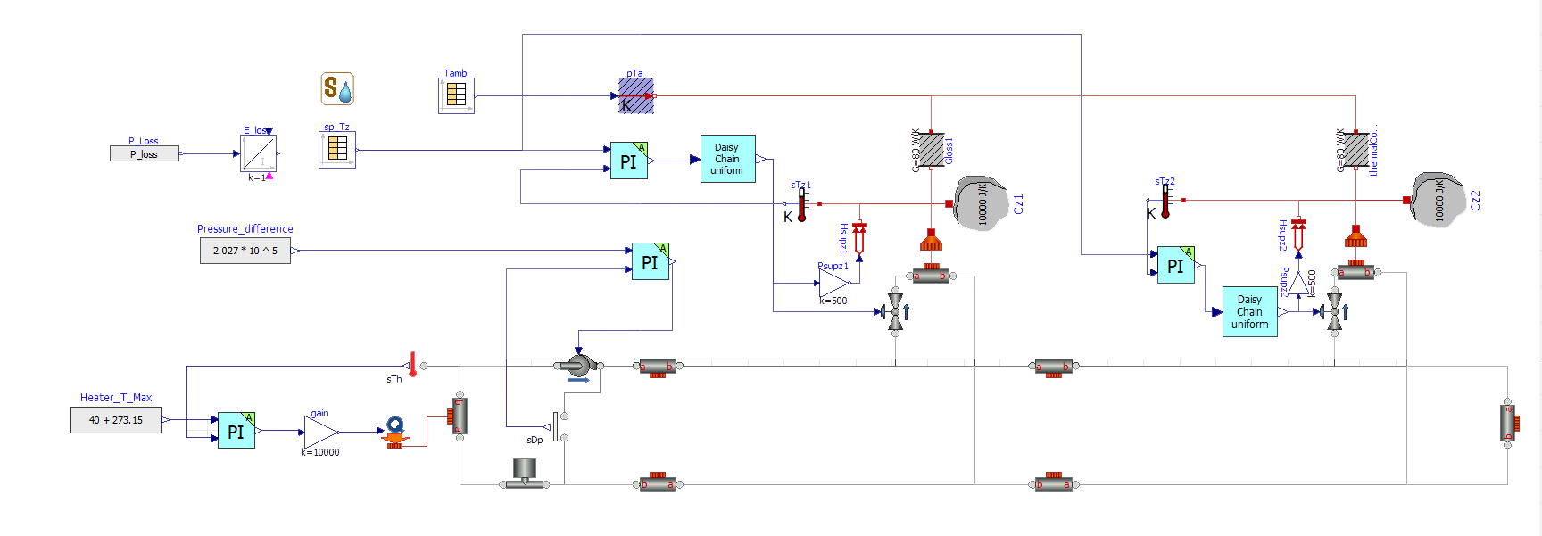
Controlled system

Slide 4
Heater model and tracking

Slide 5
Pump model

Slide 6
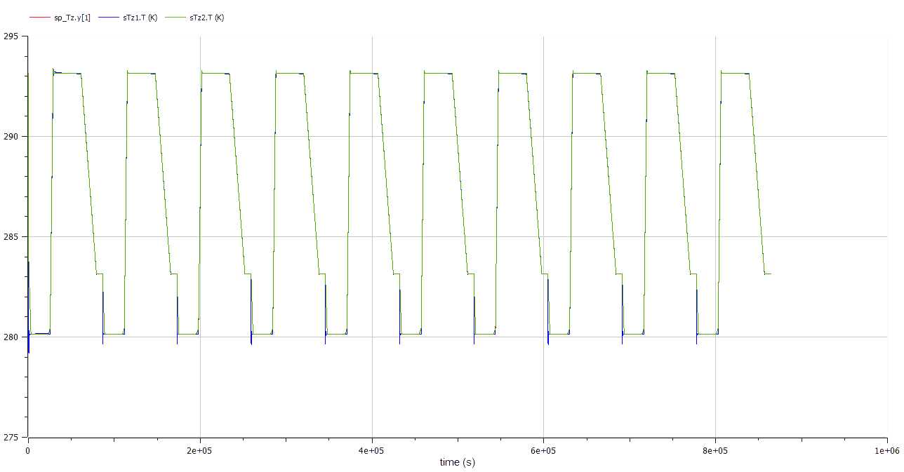

Zones models and set point tracking

Slide 7
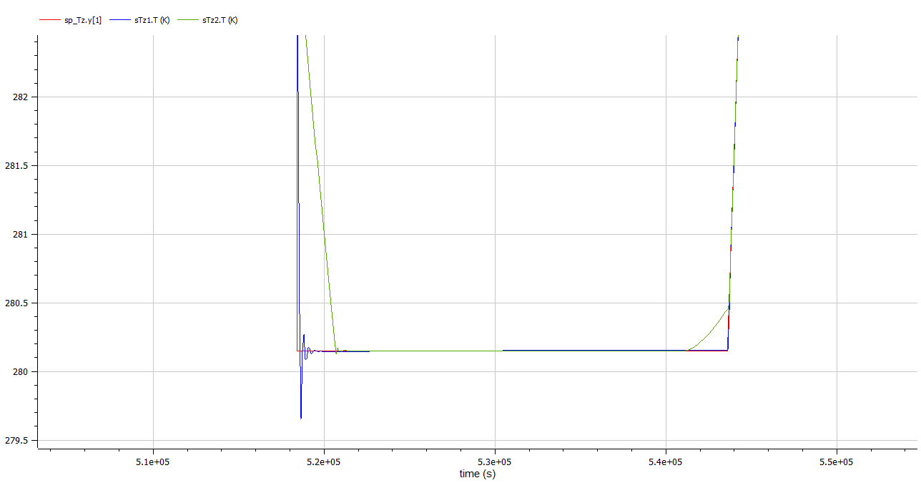

Slide 8
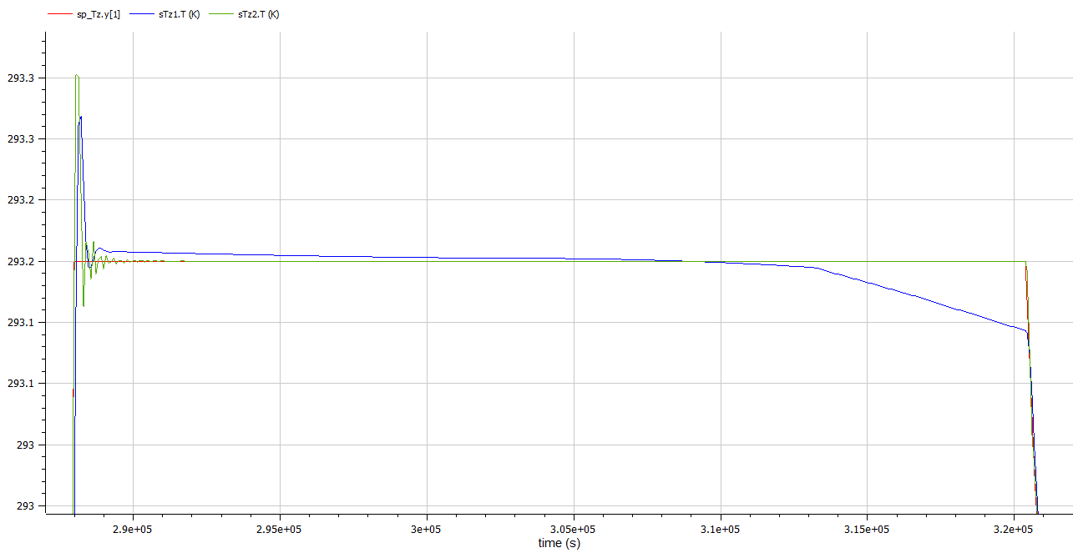

Slide 9
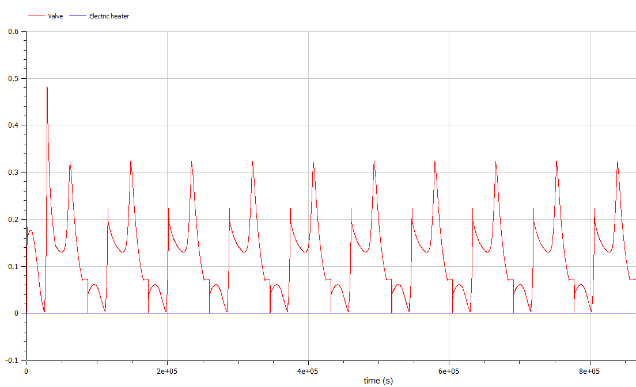
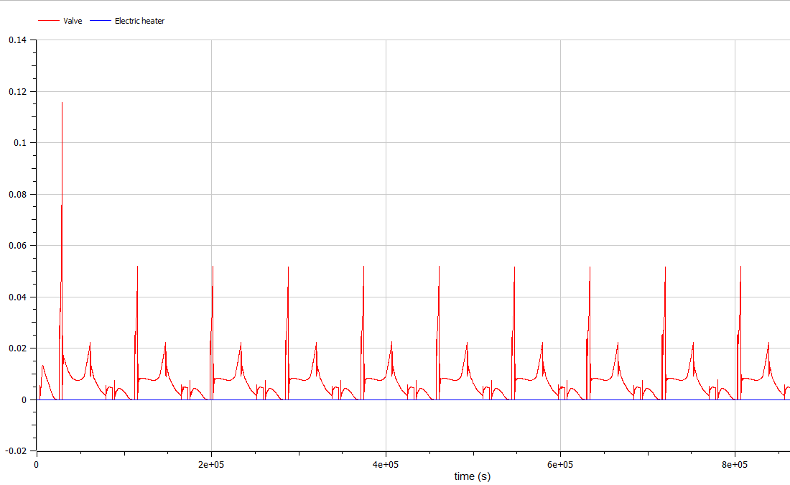
Control signals of each actuator

Slide 10
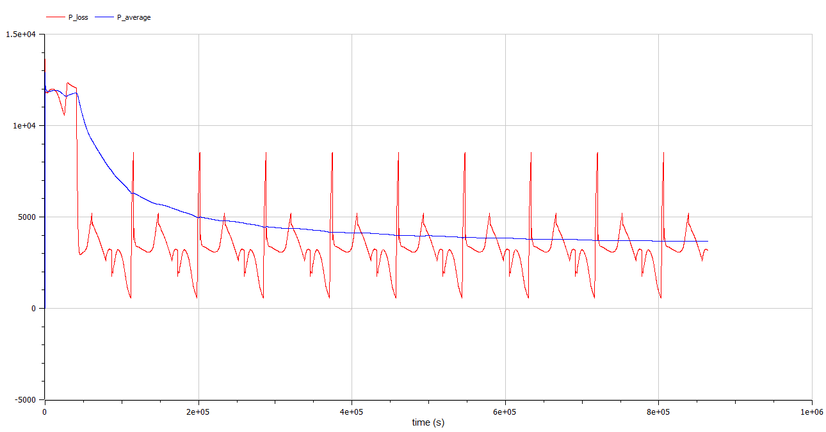
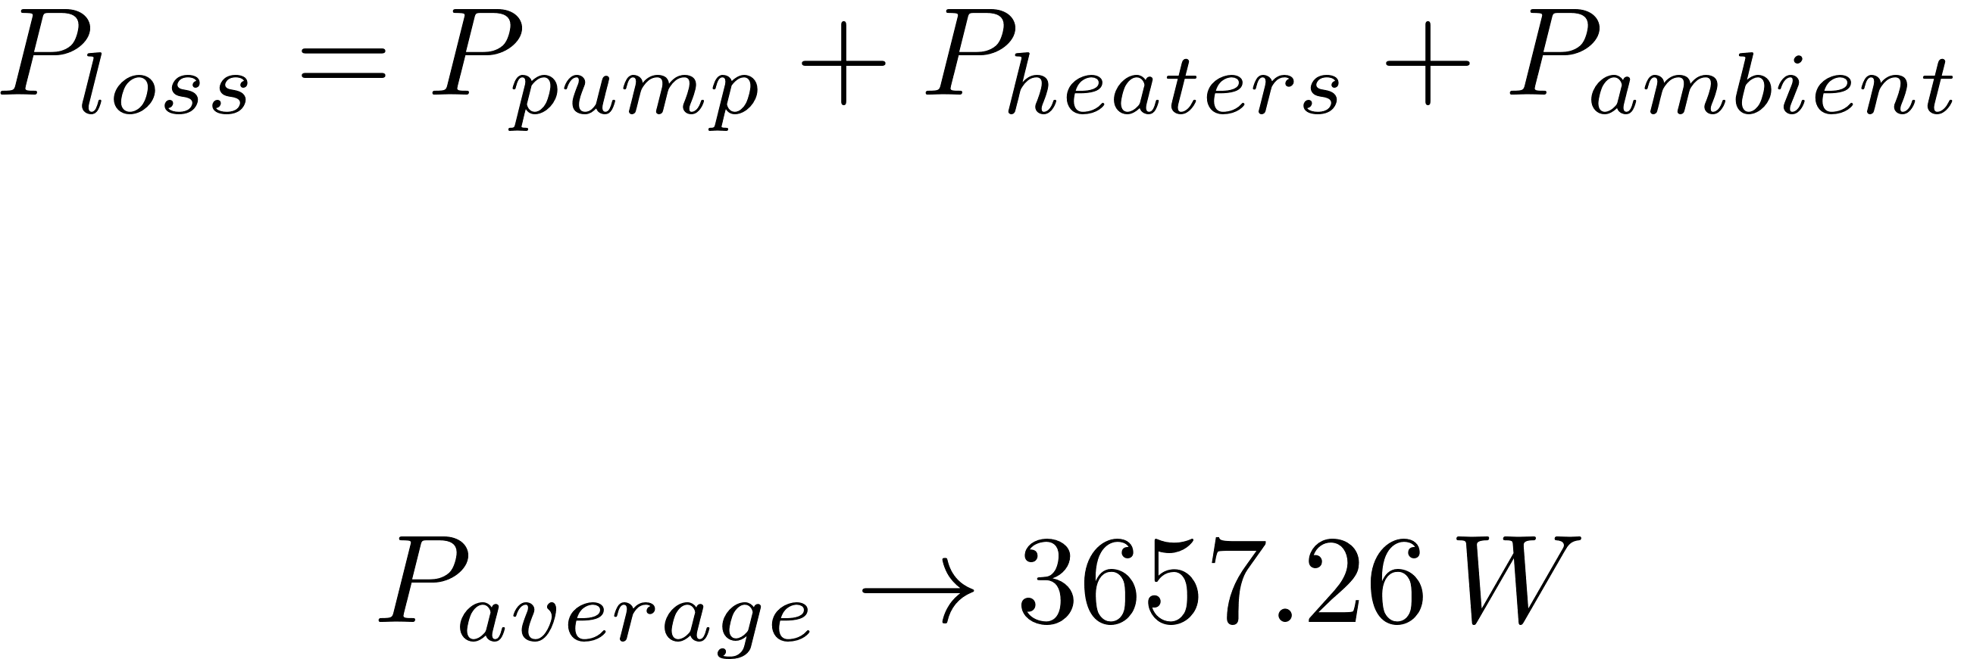
Power consumption

Slide 11
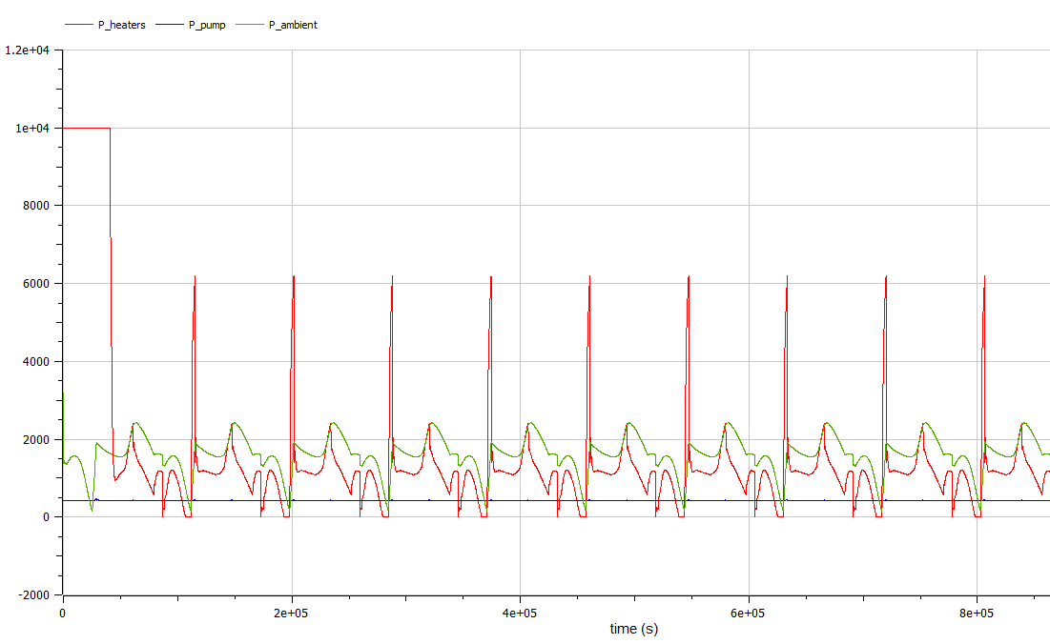
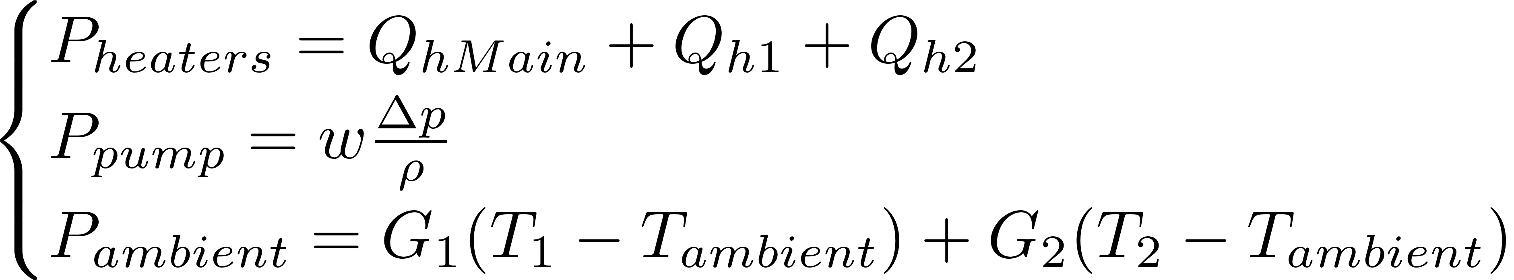
Individual power consumptions

Slide 12
